Slide 1
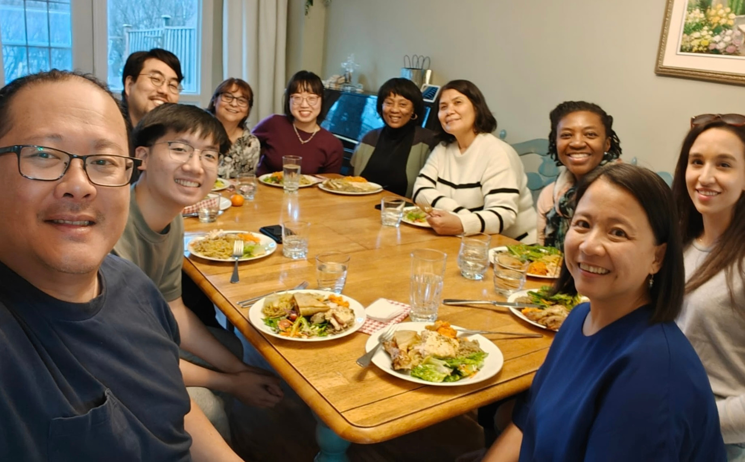


Host Some International Students for Dinner this Easter
REGISTER AT FriendsForDinner.ca

