Slide 1
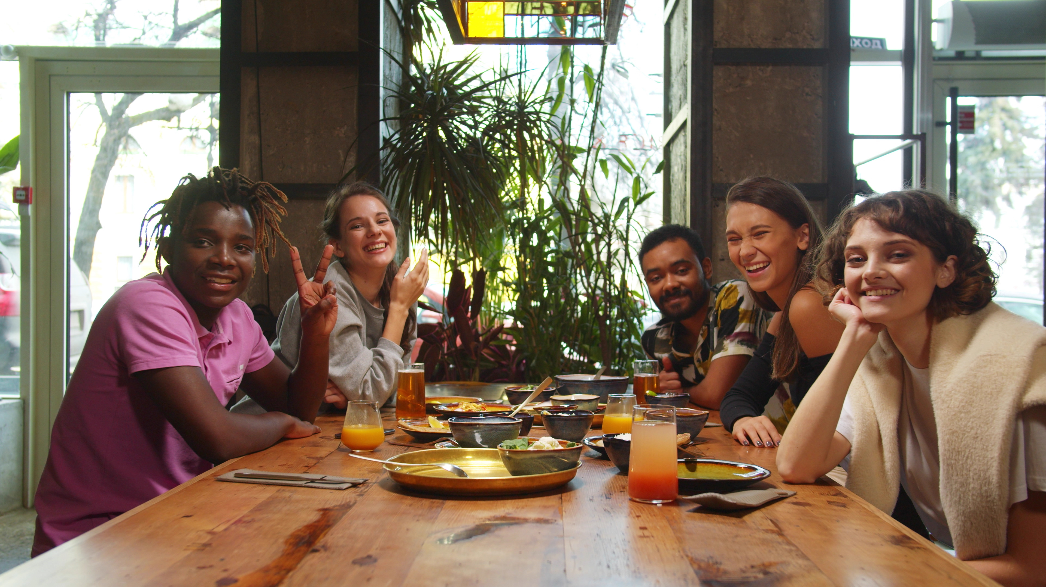
Host some international students for
Thanksgiving!
Register at
friendsfordinner.ca
by September 30

