Slide 1
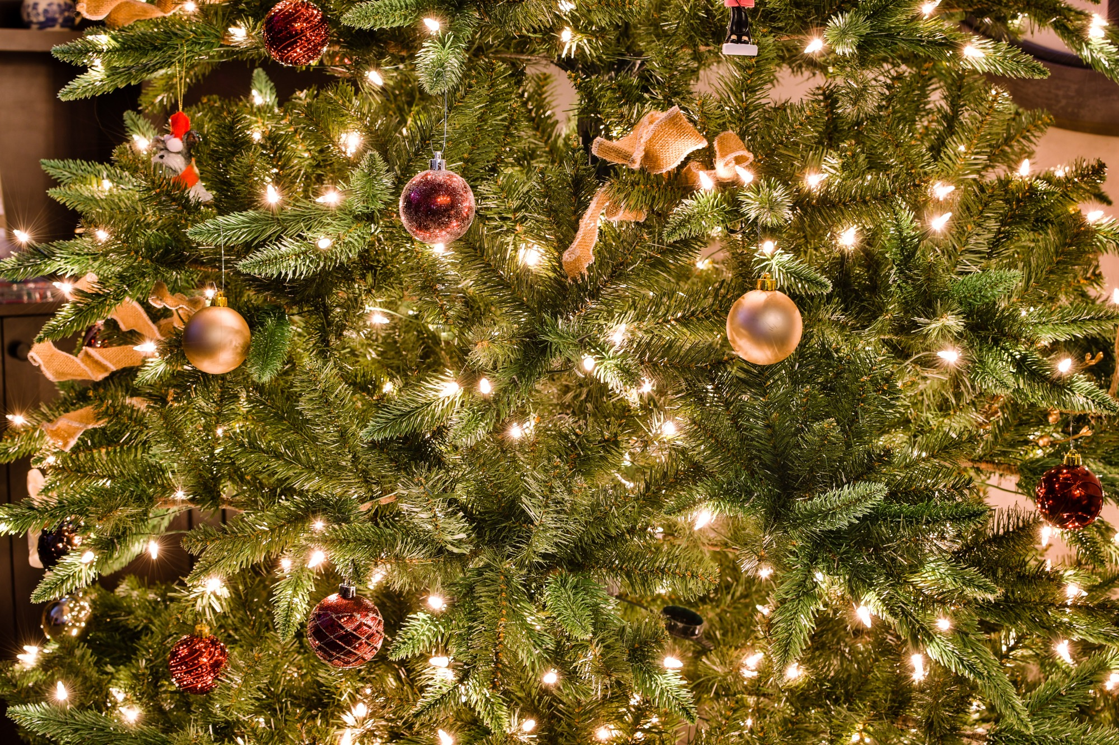
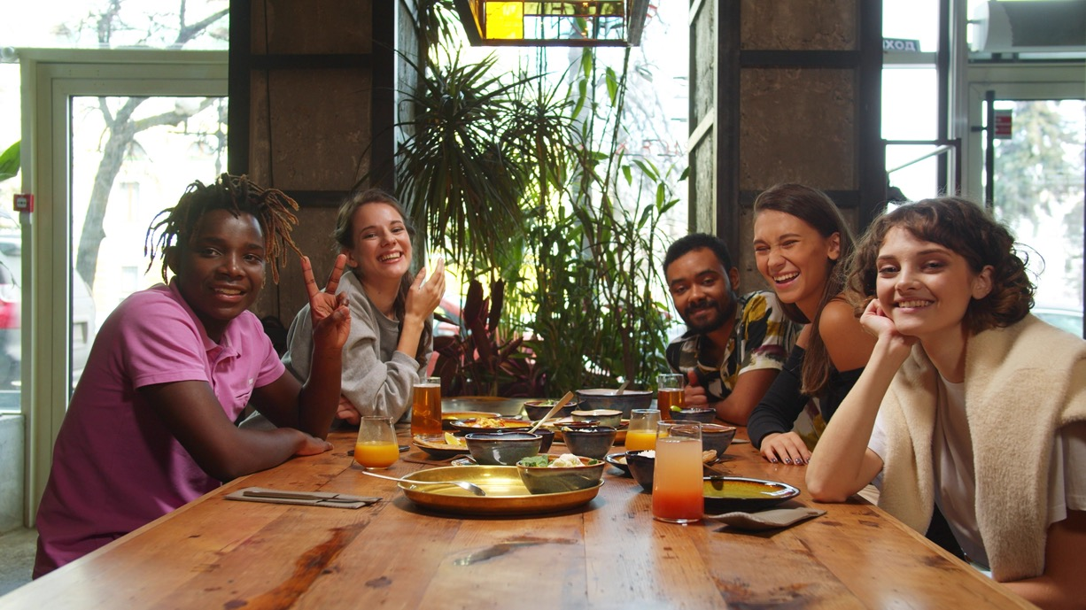
Host an International Student
in Your Home for Christmas!
Register at
friendsfordinner.ca
You choose the date.
We will match you with your student guests.
Deadline: December 11

